Slide 1

CFA in R
Psych 740: Theory Building & Model Testing

Slide 2
Overview of Slides
CFA using lavaan
Specifying the model
Estimating the model
Output interpretation
Plotting the model

Slide 3
Additional lavaan CFA Commands
Syntax | Command | Example
=~ | Latent variable definition | latent variable =~ indicator1 + indicator2 + indicator3

Slide 4
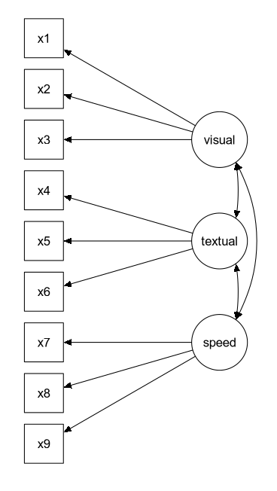
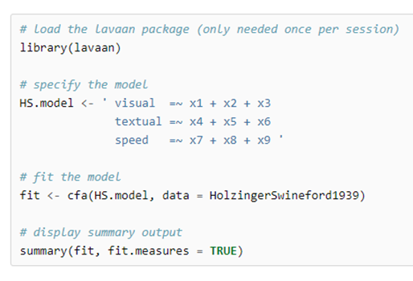
lavaan Tutorial Site Example
For each latent factor, lavaan will fix the loading of the first listed indicator to 1.
Variances of the latent factors and covariances among the latent factors will automatically be estimated, so they don’t need to be specified in the model.

Slide 5
One Factor Model Example
Example using the survey.csv data file
Say we want to fit a one-factor CFA using the five life satisfaction items.

Slide 6

Model Specification
We first must build our model.
I named the model “CFAmodel. Then in the model, I named the latent factor “lifeSatisfaction (but you could name it whatever you want).
The =~ signs say to estimate a latent factor with the five indicators included to the right.
The loading of the first listed indicator (“lifsat1”) will be fixed to one. If you would like to use another indicator as the reference, you could simply rearrange the listing of the indicators (e.g., =~ lifsat2 + lifsat1 + lifsat3 etc.)

Slide 7
Model Specification
As a default, factor variances, factor covariances, and residual/error variances will automatically be estimated and tested in the model (so you do not need to define them in the model specification).

Slide 8

Model Estimation
We could then estimate the model using the following code:
We use the cfa() function from lavaan
We supply it the model that we specified (in this example, it is just called CFAmodel)
We say what data file we should pull the data from (in this example, it is the survey data file)
We use the summary() function to get the output

Slide 9
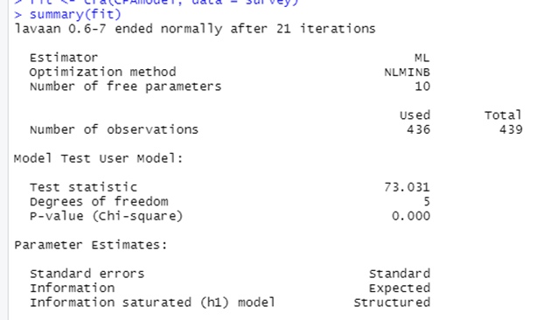
Output
Information is first outputted that deals with the overall model (e.g., estimation method, # of free parameters, sample size, df of the model).

Slide 10
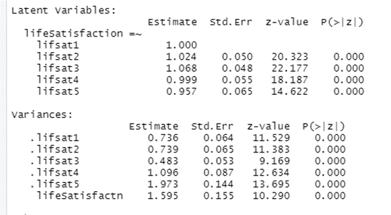
Output
The Latent Variables output has the unstandardized factor loadings. The Variances output has the unstandardized variances (for the indicators and the latent factor)

Slide 11
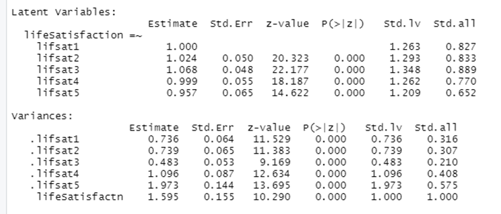
Standardized Estimates
Add standardized = TRUE to the summary() function: summary(fit, standardized = TRUE)
The “Std.all” column toward the right contains the completely standardized solution coefficients

Slide 12
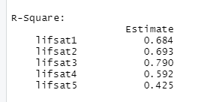
R-Square values
Add rsq = TRUE to the summary() function to get the variance accounted for in each indicator by the latent factor: summary(fit, rsq = TRUE)

Slide 13
Bootstrapping
If bootstrapping is desired for the standard errors, add se = “bootstrap” and bootstrap = XXX to the cfa() function with XXX = the number of bootstrap samples: cfa(CFAmodel, data = survey, se = "bootstrap", bootstrap = 5000)
FYI: it can take awhile for the bootstrapping to complete. But once completed, the summary() results will include the bootstrap standard errors

Slide 14
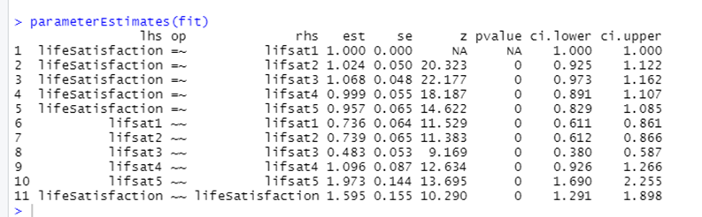
Other post-estimation commands
The parameterEstimates() function extracts additional information about the parameters (e.g., confidence intervals)

Slide 15
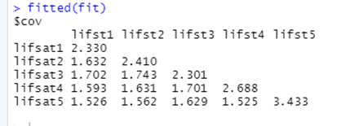
Additional post-estimation commands
If you want to see the model-implied (fitted) covariance matrix, use the fitted() function.

Slide 16
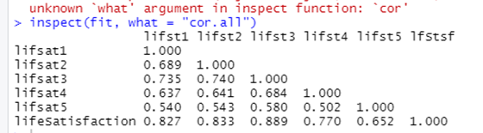
Additional post-estimation commands
If you want to see the model-implied (fitted) correlation matrix, use the inspect() function.
Example: inspect(fit, what = “cor.all”)

Slide 17
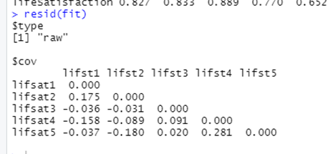
Additional post-estimation commands
If you want to see the residual covariance matrix, use the resid() function.
If you want to see the (standardized) or (normalized) residual covariance matrix, add type = “normalized” or type = “standardized” to the resid() function.
Examples:
resid(fit, type = “normalized”)
resid(fit, type = “standardized”)

Slide 18
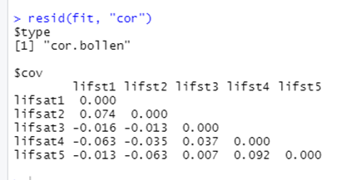
Additional post-estimation commands
If you want to see the residual correlation matrix, use the resid() function.
Example: resid(fit, “cor”)

Slide 19
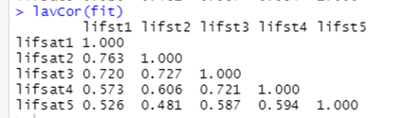
Additional post-estimation commands
If you want to see the observed correlation matrix, you can always use the lavCor() function

Slide 20
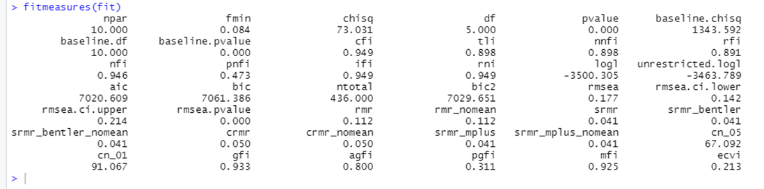
Additional post-estimation commands – Model fit measures
If you want to see additional model fit estimates, use the fitMeasures() function.

Slide 21
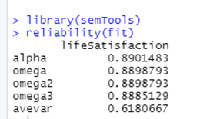
Additional post-estimation commands – Factor reliability and validity
If you want to see the convergent validity of the latent factor, use the reliability() function from the semTools package.
alpha: coefficient (Cronbach’s) alpha
omega: Raykov’s coefficient omega
omega2: Bentler’s coefficient omega
omega3: McDonald’s coefficient omega
avevar: average variance extracted (calculation is slightly different from the traditional Fornell & Larcker method)

Slide 22
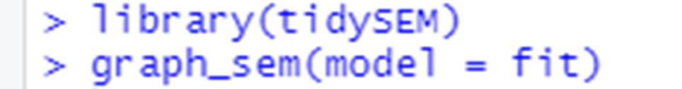
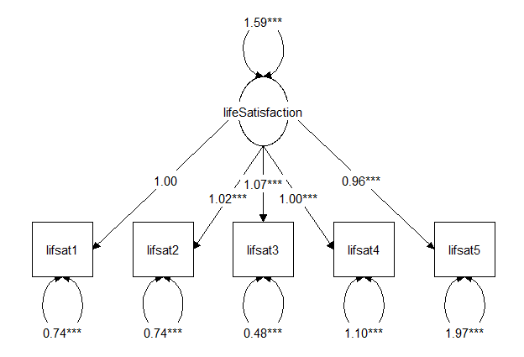
Plotting the CFA
If you want to see a visualization of the CFA model, use the graph_sem() function from the tidySEM package.
The coefficient values are the unstandardized coefficients.
For additional tutorial on using the tidySEM package, see:
https://cran.r-project.org/web/packages/tidySEM/vignettes/Plotting_graphs.html

Slide 23
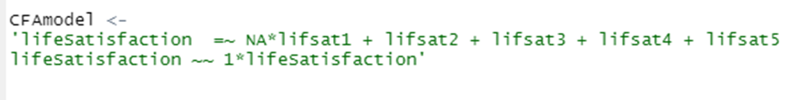
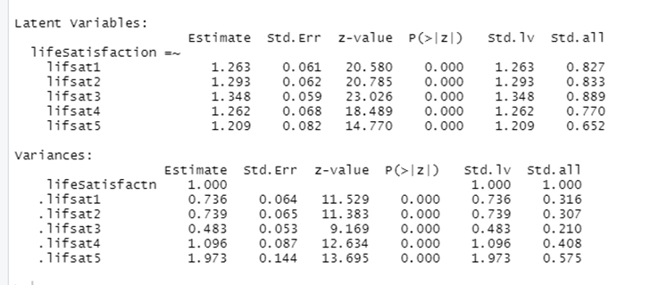
Fixing Parameters
As a default, lavaan will fix the factor loading of the first indicator to 1. If you instead want to fix the variance of the latent factor to 1, the code would look something like:
By adding NA* before the first indicator, that will change the first loading to be a free parameter to be estimated
Adding “lifeSatisfaction ~~ 1*lifeSatisfaction” to the model will specify the factor variance to be 1

Slide 24
Two Factor Model Example
Example using the survey.csv data file
Say we want to fit a two-factor CFA using the five life satisfaction items as one factor and the six optimism items as the second factor.

Slide 25
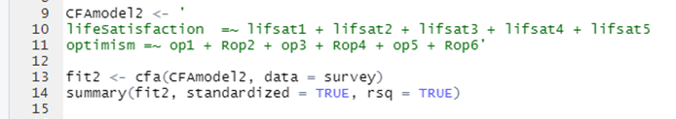
Model Specification

Slide 26
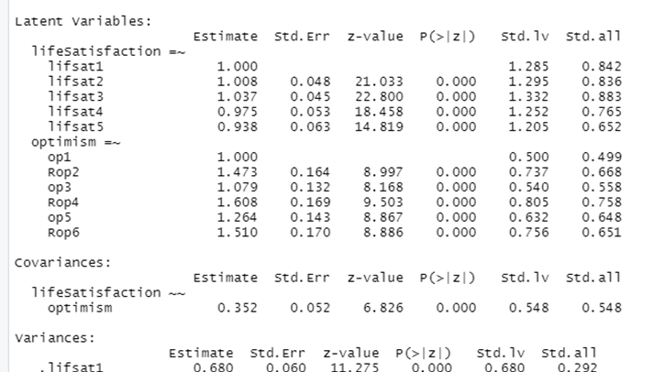
Model Output
The “Covariances” output contains the relationship between the two latent factors. The “Estimate” is the unstandardized estimate (covariance) and the “Std.all” value is the standardized estimate (correlation)

